Slide 1

Movie Ticket Booking System
by Saad Ahmed Shaikh
FINISH

Slide 2







ABSTRACT
The Movie Ticket Booking System is a database designed to manage movie schedules, customer bookings, and theater operations efficiently. It comprises six key tables—Movies, Theaters, Screens, Showtimes, Customers, and Bookings—to model the relationships between entities. This project demonstrates essential SQL concepts such as data organization, relationships, and advanced queries. It provides a practical approach to understanding database management in real-world scenarios, particularly in the entertainment industry.

Slide 3
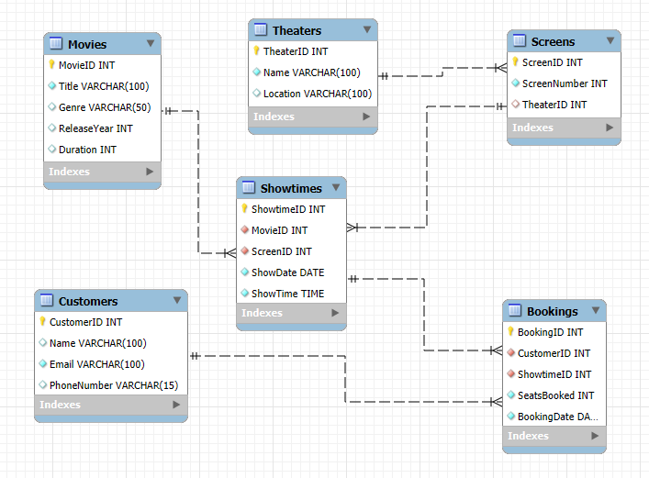
ER Diagram

Slide 4
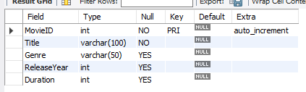
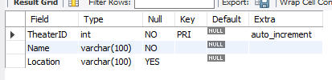
Structure Of Tables
describe Movies;
describe Theaters;

Slide 5

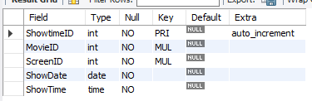
Structure Of Tables
describe screens;
describe showtimes;

Slide 6
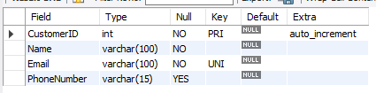
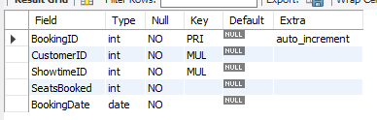
Structure Of Tables
describe customers;
describe Movies;

Slide 7
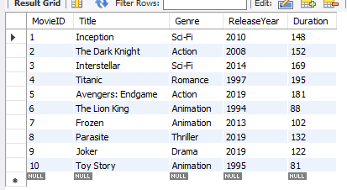
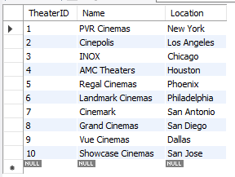
Contents Of Tables
select * from Movies;
select * from Theaters;

Slide 8
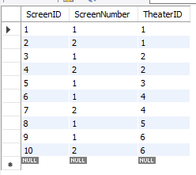
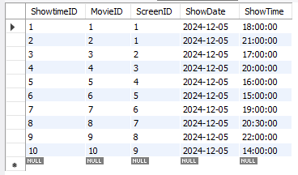
Contents Of Tables
select * from screens;
select * from showtimes;

Slide 9
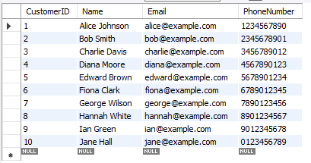
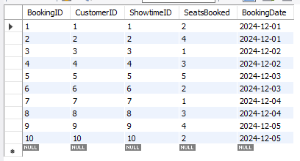
Contents Of Tables
select * from customers;
select * from bookings;

Slide 10


Basic Queries
List all customers whose name starts with 'A'
2.Retrieve all theaters in a specific location (e.g., 'Los Angeles')
SELECT *
FROM Customers
WHERE Name LIKE 'A%';
SELECT Name, Location FROM Theaters
WHERE Location = 'Los Angeles';

Slide 11


Basic Queries
3.Find the total number of movies in the database
4.Find movies grouped by genre and count the number of movies in each genre
SELECT COUNT(*) AS TotalMovies
FROM Movies;
SELECT Genre, COUNT(*) AS NumberOfMovies
FROM Movies
GROUP BY Genre
HAVING COUNT(*) > 1;

Slide 12
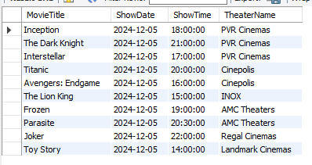
Join Queries
Show all showtimes with their movie titles and theater names
SELECT M.Title AS MovieTitle, S.ShowDate, S.ShowTime, T.Name AS TheaterName FROM Showtimes S
INNER JOIN Movies M ON S.MovieID = M.MovieID INNER JOIN Screens Sc ON S.ScreenID = Sc.ScreenID
INNER JOIN Theaters T ON Sc.TheaterID = T.TheaterID;

Slide 13
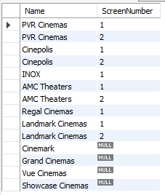
Join Queries
2.Display names of all theaters along with their corresponding screen numbers, including theaters without screens
SELECT t.Name, s.ScreenNumber
FROM Theaters t
LEFT JOIN Screens s ON t.TheaterID = s.TheaterID;

Slide 14
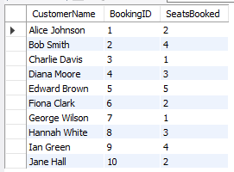
Join Queries
3.List all customers and their bookings
SELECT C.Name AS CustomerName, B.BookingID, B.SeatsBooked
FROM Bookings B RIGHT JOIN Customers C ON B.CustomerID = C.CustomerID;

Slide 15
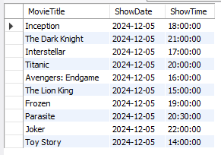
Join Queries
4.Find all movies and showtimes
SELECT M.Title AS MovieTitle, S.ShowDate, S.ShowTime
FROM Movies M LEFT JOIN Showtimes S ON M.MovieID = S.MovieID
UNION SELECT M.Title AS MovieTitle, S.ShowDate, S.ShowTime
FROM Showtimes S RIGHT JOIN Movies M ON S.MovieID = M.MovieID;

Slide 16
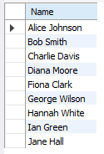

Sub-Queries
1.Find movies with the highest number of bookings
2.List all customers who booked less than 5 seats in total
SELECT Title
FROM Movies
WHERE MovieID = ( SELECT S.MovieID
FROM Bookings B
JOIN Showtimes S ON B.ShowtimeID = S.ShowtimeID
GROUP BY S.MovieID
ORDER BY COUNT(B.BookingID) DESC
LIMIT 1 );
SELECT Name
FROM Customers
WHERE CustomerID IN ( SELECT CustomerID
FROM Bookings
GROUP BY CustomerID
HAVING SUM(SeatsBooked) < 5 );

Slide 17
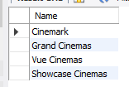

Sub-Queries
3.Find theaters that have no scheduled shows
4.Find the second most booked movie
SELECT Name
FROM Theaters
WHERE TheaterID NOT IN ( SELECT DISTINCT Sc.TheaterID
FROM Screens Sc JOIN Showtimes S ON Sc.ScreenID = S.ScreenID );
SELECT Title FROM Movies WHERE MovieID = ( SELECT MovieID FROM Showtimes S JOIN Bookings B ON S.ShowtimeID = B.ShowtimeID GROUP BY MovieID ORDER BY COUNT(B.BookingID) DESC LIMIT 1 OFFSET 1 );

Slide 18
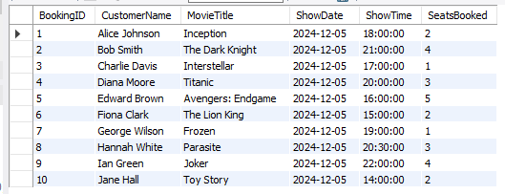
View
Create a view to show detailed booking information with customer and movie details
CREATE VIEW BookingDetails AS
SELECT B.BookingID, C.Name AS CustomerName, M.Title AS MovieTitle, S.ShowDate, S.ShowTime, B.SeatsBooked
FROM Bookings B JOIN Customers C ON B.CustomerID = C.CustomerID
JOIN Showtimes S ON B.ShowtimeID = S.ShowtimeID JOIN Movies M ON S.MovieID = M.MovieID;
select * from bookingdetails;

Slide 19
Thank You
by Saad Ahmed Shaikh
FINISH

